Slide 1

An Introduction to LISP
Using the compilers conforming to Common Lisp of:
Steel Bank Common Lisp ~ SBCL
&
CLISP
Waikato Linux Users Group
Ian Stewart & Jake Waas
23 November 2020

Slide 2
Contents
Demo Files.
demo_1.lisp 15
demo_print.lisp 16
demo_format.lisp 18
demo_input.lisp 22
demo_radio.lisp 24
demo_2.lisp 28
demo_math.lisp 40
demo_trig.lisp 47
demo_date.lisp 51
demo_file.lisp 53
3 History
4 Algebraic Notation
5 Comments and Blank lines
6 Parenthesis and Whitespace
7 Documentation Links
8 Installation on Linux / Debian platform SBCL and CLISP
9 CLISP interpreter, (read-line), (describe)
12 SBCL interpreter, rlwrap, (describe)
14 Interpreter, print and princ vs. Running script.
16 Output to Console.
22 Input to Console. Mock Radio Menu
26 SBCL Command line Help
28 SBCL Shebang
30 COMMON-LISP Package
40 Maths Functions
49 Trig Functions
51 Date and Tme Functions
53 File I/O
58 Appendix 1: Geany Modifications. Appendix 2: Apropos function.

Slide 3
History
LISP derives from LISt Processor
Originally created as a practical mathematical notation by John McCarthy in 1958.
Steve Russell wrote the Lisp interpreter.
1962 Lisp compiler.
Second oldest commonly used language after Fortran.
All program code is written as s-expressions, or parenthesized lists.
Data may be a list. E.g.: '( "A" "B" "C") or (list 1 2 3 4).
Function may be a list: ( + 2 3 ) Add 2 and 3 to return a result of 5.
Many variations of Lisp. Common Lisp in 1984 a consolidaton.
Compilers: CLISP and Steel Bank Common Lisp (SBCL)
Ubuntu $ apt search lisp finds CLISP and SBCL
CLISP V2.49 – July 2010
SBCL V2.0.10 – October 2020

Slide 4
Algebraic Notations
Infix notation: 5 * 2 + 3
Postfix notation (Reverse Polish Notation): 5 2 * 3 +
    No need not to have Operator Precedence.
Prefix notation: + 3 * 5 2
Lisp notation (+ (* 5 2) 3)
    sexp (short for S-Expression, where S stands for Symbolic).
    It is sometimes known as Fully Parenthesized Notation.
functional notation +( *(5 2) 3)
matchfix notation: (* (+ 5 2 +) 3 *)
Reference: http://xahlee.info/UnixResource_dir/writ/notations.html

Slide 5
Notation. Comments and Blank lines
Lisp comments notation examples:
;;;; Main heading for program is
;;;; four semi-colons.
;;; Section 1. Three semi-colons.
;; Sub-secton 1a. The next part of the program.
(print (lisp-implementation-type)) ; Comment. prints SBCL.
#|
This comment, using hash and vertical bar
is spread over multiple lines.
|#

Slide 6
Notation. Parenthesis and Whitespace
Lisp notation examples (function arg arg):
(+ 3 4) ; Result is 7
(* 2 (+ 3 4)) ; Result is 14
Left and Right parenthesis pairs must match.
Function first followed by arguments.
A space character delimits functions and arguments
May have multiple whitespace characters. Spaces, tabs newlines.
Four examples of the same multiplication function that return 6:
( print ( * 2 3 ) )
(print( * 2 3 ))
(print(* 2 3))
(print
(
* 2 3
)
)

Slide 7
Documentation Links
Documentation Internal
http://www.sbcl.org/manual/index.html
http://www.gigamonkeys.com/book/
http://www.lispworks.com/documentation/common-lisp.html
https://www.gnu.org/software/emacs/manual/html_node/elisp/
http://www.ai.mit.edu/projects/iiip/doc/CommonLISP/HyperSpec/FrontMatter/Chapter-Index.html
http://www.lispworks.com/documentation/HyperSpec/Front/Contents.htm
https://www.tutorialspoint.com/lisp/
https://riptutorial.com/Download/common-lisp.pdf
* (documentation 'princ 'function)
"Output an aesthetic but not necessarily READable printed representation
of OBJECT on the specified STREAM."
* (describe 'princ)

Slide 8
Installation
CLISP. Website: https://clisp.sourceforge.io/
$ sudo apt install clisp clisp-doc
SBCL. Website: http://www.sbcl.org/
$ sudo apt install sbcl sbcl-doc
$ sudo apt install rlwrap
Latest sbcl may be downloaded from web-site as AMD64 binary.
http://www.sbcl.org/platform-table.html
rlwrap for SBCL – Thanks to Lawrence D’Oliveiro

Slide 9
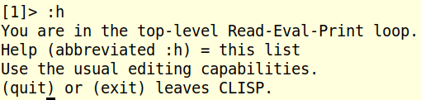
CLISP Launch
ian@ian:~$ clisp
i i i i i i i ooooo o ooooooo ooooo ooooo
I I I I I I I 8 8 8 8 8 o 8 8
I \ `+' / I 8 8 8 8 8 8
\ `-+-' / 8 8 8 ooooo 8oooo
`-__|__-' 8 8 8 8 8
| 8 o 8 8 o 8 8
------+------ ooooo 8oooooo ooo8ooo ooooo 8
Welcome to GNU CLISP 2.49.92 (2018-02-18) <http://clisp.org/>
Copyright (c) Bruno Haible, Michael Stoll 1992-1993
Copyright (c) Bruno Haible, Marcus Daniels 1994-1997
Copyright (c) Bruno Haible, Pierpaolo Bernardi, Sam Steingold 1998
Copyright (c) Bruno Haible, Sam Steingold 1999-2000
Copyright (c) Sam Steingold, Bruno Haible 2001-2018
Type :h and hit Enter for context help.
[1]> (quit)
Bye.
ian@ian:~$
(quit) or (exit) or Ctrl D to get out and back to bash prompt

Slide 10
CLISP includes GNU_Readline
Type :h and hit Enter for context help.
[1]> (princ "hello world")
"(princ \"hello world\")" ;
hello world
"hello world"
[2]> (princ "hello world")
hello world
"hello world"
[3]> (princ "hello world")
hello world
"hello world"
[4]> (princ "up arrow gets history OK")
up arrow gets history OK
"up arrow gets history OK"
[5]> (+ 2 3)
5
[6]> (+ 2 3)
5
Reference: https://en.wikipedia.org/wiki/GNU_Readline
Up-Arrow recalls last line. Plus Ctrl A start, Ctrl E end, etc.

Slide 11
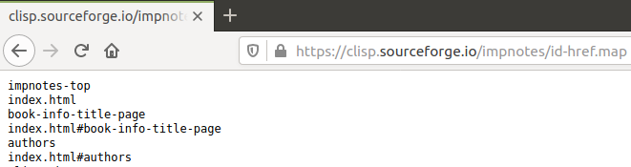
CLISP (print (describe 'print))
PRINT is the symbol PRINT, lies in #<PACKAGE COMMON-LISP>, is accessible in 11
packages CLOS, COMMON-LISP, COMMON-LISP-USER, EXPORTING, EXT, FFI, POSIX,
READLINE, REGEXP, SCREEN, SYSTEM, names a
;; connecting to "http://www.ai.mit.edu/projects/iiip/doc/CommonLISP/HyperSpec/Data/Symbol-Table.text"...connected...HTTP/1.1 200 OK...45,322 bytes
;; SYSTEM::GET-CLHS-MAP(#<IO INPUT-BUFFERED SOCKET-STREAM CHARACTER www.ai.mit.edu:80>)...978/978 symbols
function.
ANSI-CL Documentation is at
"http://www.ai.mit.edu/projects/iiip/doc/CommonLISP/HyperSpec/Body/fun_writecm_p_rintcm_princ.html"
;; connecting to "http://clisp.org/impnotes/id-href.map"...connected...HTTP/1.1 301 Moved Permanently --> "https://clisp.sourceforge.io/impnotes/id-href.map"
*** - OPEN-HTTP("https://clisp.sourceforge.io/impnotes/id-href.map"): HTTPS
protocol is not supported yet
ian@ian:~/lisp$
No https only http
~ huh?
4000+ entries

Slide 12

SBCL Launch and Readline
ian@ian:~$ sbcl
This is SBCL 2.0.1.debian, an implementation of ANSI Common Lisp.
More information about SBCL is available at <http://www.sbcl.org/>.
SBCL is free software,... for more information.
* ^[[A^A^E
* (quit)
ian@ian:~$ rlwrap sbcl
This is SBCL 2.0.1.debian, an implementation of ANSI Common Lisp.
More information about SBCL is available at <http://www.sbcl.org/>.
SBCL is free software,... for more information.
* (+ 2 3)
5
* (+ 2 3)
No “help” like CLISP
No readline. Trying to do up-arrow and Ctrl A/E start / end of line
Have Readline. E.g. Up-arrow displays previous command line, etc.

Slide 13
SBCL (print (describe 'print))
COMMON-LISP:PRINT
[symbol]
PRINT names a compiled function:
Lambda-list: (SB-IMPL::OBJECT &OPTIONAL STREAM)
Declared type: (FUNCTION (T &OPTIONAL (OR STREAM BOOLEAN))
(VALUES T &OPTIONAL))
Derived type: (FUNCTION (T &OPTIONAL T) (VALUES T &OPTIONAL))
Documentation:
Output a newline, the mostly READable printed representation of OBJECT, and
space to the specified STREAM.
Known attributes: unwind, any
Source file: SYS:SRC;CODE;PRINT.LISP
SBCL (describe) OK – No Error

Slide 14
SBCL Command line Interpreter
* ( + 2 3 )
5
* (* 2 3)
6
* (print (* 2 3))
6
6
* (print (+ 2 3))
5
5
* (princ (+ 2 3))
5
5
* (princ (* 2 3))
6
6
1. Interactive. Result displayed
2. Print inserts newline.
3. Princ no newline

Slide 15
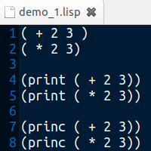
SBCL Save file as demo_1.lisp
1
2
ian@ian:~/lisp/sbcl$ sbcl --load demo_1.lisp
This is SBCL 2.0.1.debian, an implementation of ANSI Common Lisp.
More information about SBCL is available at <http://www.sbcl.org/>.
SBCL is free software, provided as is, with absolutely no warranty.
It is mostly in the public domain; some portions are provided under
BSD-style licenses. See the CREDITS and COPYING files in the
distribution for more information.
5
6 56
*
3
2 Print preceeds result with newline
3 Princ no newline
File: demo_print.lisp

Slide 16
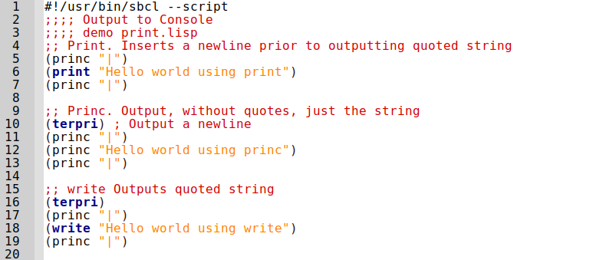
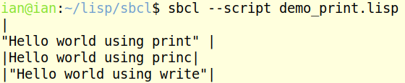
Output to Console.
Must be double quotes. " not '
princ does not provide new-line. Use (terpri) to insert newlines
File: demo_print.lisp

Slide 17
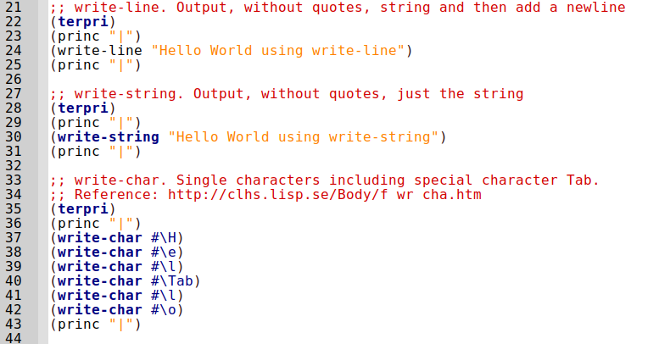
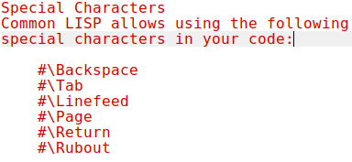

Output to Console continued...
File: demo_print.lisp

Slide 18
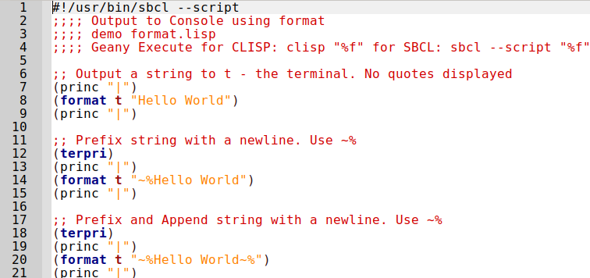
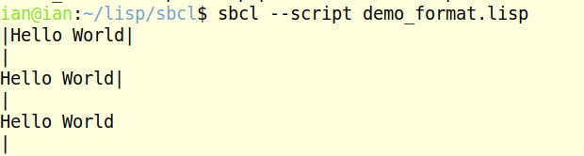
Output to Console. Format...
http://www.gigamonkeys.com/book/a-few-format-recipes.html
File: demo_format.lisp

Slide 19
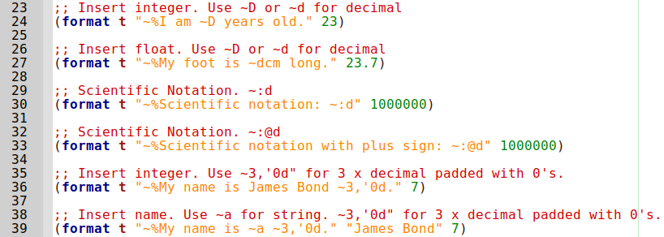
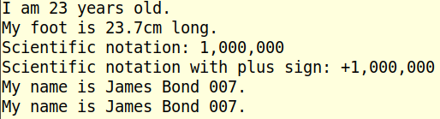
Output to Console. Format...
File: demo_format.lisp

Slide 20
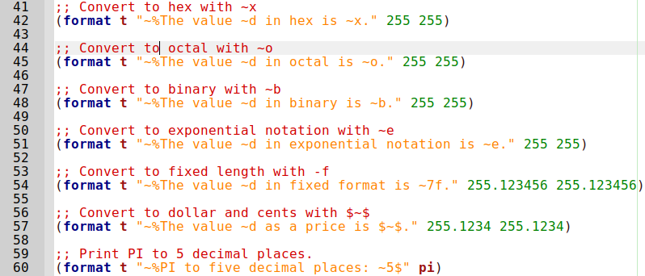
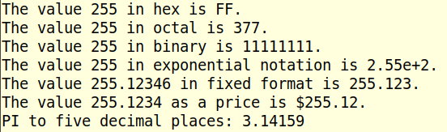
Output to Console. Format...
File: demo_format.lisp

Slide 21
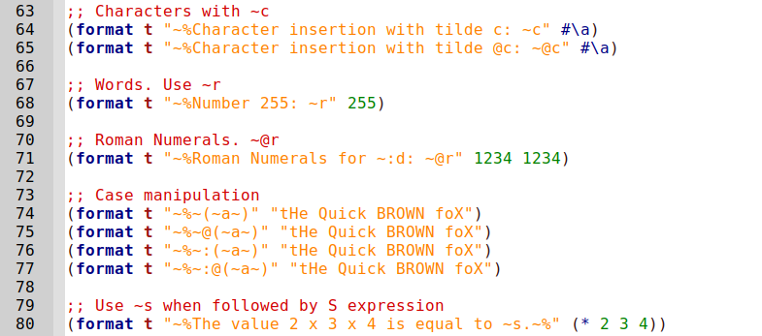
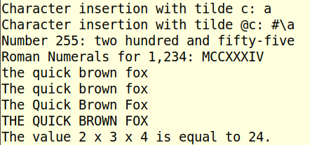
Output to Console. Format...
File: demo_format.lisp

Slide 22
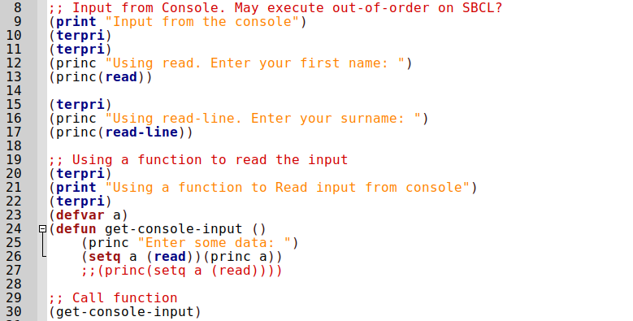
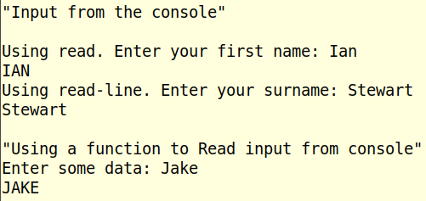
Input to Console.
File: demo_input.lisp

Slide 23
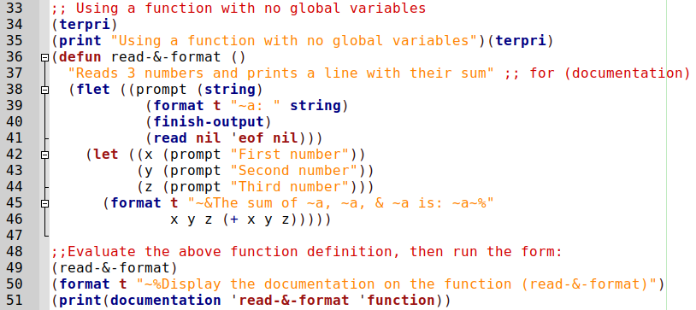
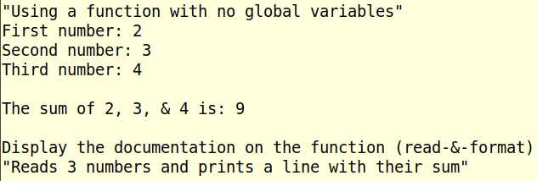
Input to Console. Continued...
flet (a function version of let) is locally defining the function 'prompt'
File: demo_input.lisp

Slide 24
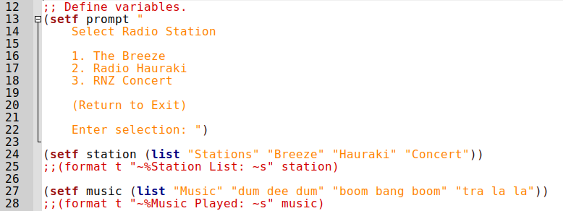
Input to Console. Mock Radio Menu
Should be a list of URL’s to Radio Stations, so audio is streamed.
File: demo_radio.lisp

Slide 25
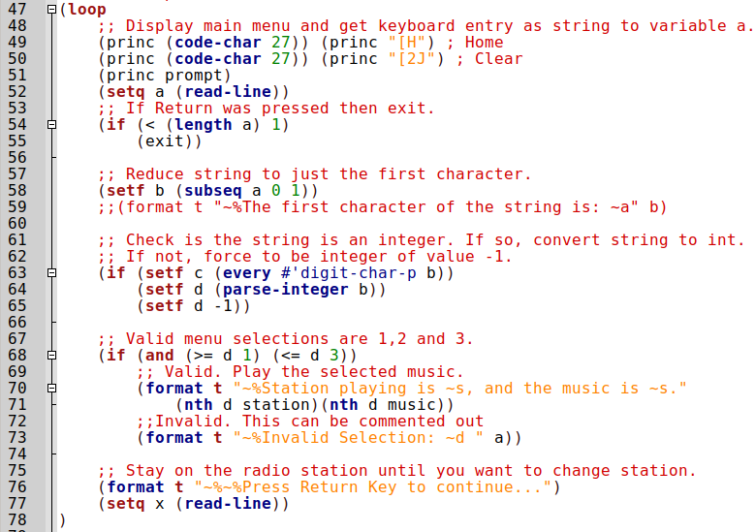
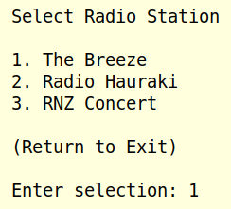
Radio
Menu...
File: demo_radio.lisp

Slide 26
SBCL Command line Help
$ sbcl --help
Usage: sbcl [runtime-options] [toplevel-options] [user-options]
Common runtime options:
--help Print this message and exit.
--version Print version information and exit.
--core <filename> Use the specified core file instead of the default.
--dynamic-space-size <MiB> Size of reserved dynamic space in megabytes.
--control-stack-size <MiB> Size of reserved control stack in megabytes.
--tls-limit Maximum number of thread-local symbols.
Common toplevel options:
--sysinit <filename> System-wide init-file to use instead of default.
--userinit <filename> Per-user init-file to use instead of default.
--no-sysinit Inhibit processing of any system-wide init-file.
--no-userinit Inhibit processing of any per-user init-file.
--disable-debugger Invoke sb-ext:disable-debugger.
--noprint Run a Read-Eval Loop without printing results.
--script [<filename>] Skip #! line, disable debugger, avoid verbosity.
--quit Exit with code 0 after option processing.
--non-interactive Sets both --quit and --disable-debugger.
Common toplevel options that are processed in order:
--eval <form> Form to eval when processing this option.
--load <filename> File to load when processing this option.
Avoid error from Shebang
Error if Shebang

Slide 27
SBCL Command line help, continued...
User options are not processed by SBCL. All runtime options must
appear before toplevel options, and all toplevel options must
appear before user options.
For more information please refer to the SBCL User Manual, which
should be installed along with SBCL, and is also available from the
website <http://www.sbcl.org/>.
http://www.sbcl.org/manual/index.html
http://www.sbcl.org/manual/sbcl.pdf

Slide 28
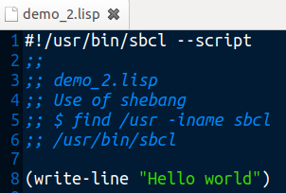
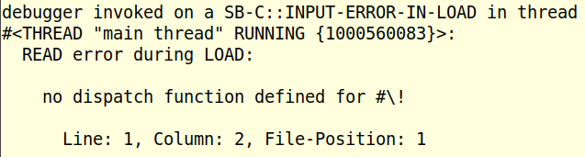
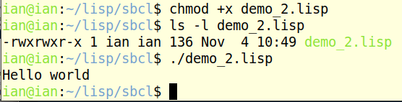
SBCL Shebang #!/usr/bin/sbcl --script
--load
--script
Uses shebang
File: demo_2.lisp

Slide 29
COMMON-LISP Package
To list the Packages:
  (print (list-all-packages))
The next 10 slides show symbols in the Common-Lisp packet.
Sorted from Lisp command:
(do-external-symbols (s (find-package "COMMON-LISP"))(print s))
978 Symbols
Red for mathematical functions
Green for Trigonometric functions

Slide 30
Common-Lisp 1/10
-1 | *LOAD-VERBOSE* | *RANDOM-STATE* | &REST | ALPHANUMERICP
1 | *MACROEXPAND-HOOK* | *READ-BASE* | &WHOLE | AND
- | *MODULES* | *READ-DEFAULT-FLOAT-FORMAT* | + | APPEND
* | *PACKAGE* | *READ-EVAL* | ++ | APPLY
** | *PRINT-ARRAY* | *READ-SUPPRESS* | +++ | APROPOS
*** | *PRINT-BASE* | *READTABLE* | < | APROPOS-LIST
*BREAK-ON-SIGNALS* | *PRINT-CASE* | *STANDARD-INPUT* | <= | AREF
*COMPILE-FILE-PATHNAME* | *PRINT-CIRCLE* | *STANDARD-OUTPUT* | > | ARITHMETIC-ERROR
*COMPILE-FILE-TRUENAME* | *PRINT-ESCAPE* | *TERMINAL-IO* | >= | ARITHMETIC-ERROR-OPERANDS
*COMPILE-PRINT* | *PRINT-GENSYM* | *TRACE-OUTPUT* | ABORT | ARITHMETIC-ERROR-OPERATION
*COMPILE-VERBOSE* | *PRINT-LENGTH* | / | ABS | ARRAY
*DEBUG-IO* | *PRINT-LEVEL* | // | ACONS | ARRAY-DIMENSION
*DEBUGGER-HOOK* | *PRINT-LINES* | /// | ACOS | ARRAY-DIMENSION-LIMIT
*DEFAULT-PATHNAME-DEFAULTS* | *PRINT-MISER-WIDTH* | /= | ACOSH | ARRAY-DIMENSIONS
*ERROR-OUTPUT* | *PRINT-PPRINT-DISPATCH* | &ALLOW-OTHER-KEYS | ADD-METHOD | ARRAY-DISPLACEMENT
*FEATURES* | *PRINT-PRETTY* | &AUX | ADJOIN | ARRAY-ELEMENT-TYPE
*GENSYM-COUNTER* | *PRINT-RADIX* | &BODY | ADJUST-ARRAY | ARRAY-HAS-FILL-POINTER-P
*LOAD-PATHNAME* | *PRINT-READABLY* | &ENVIRONMENT | ADJUSTABLE-ARRAY-P | ARRAY-IN-BOUNDS-P
*LOAD-PRINT* | *PRINT-RIGHT-MARGIN* | &KEY | ALLOCATE-INSTANCE | ARRAY-RANK
*LOAD-TRUENAME* | *QUERY-IO* | &OPTIONAL | ALPHA-CHAR-P | ARRAY-RANK-LIMIT

Slide 31
Common-Lisp 2/10
ARRAY-ROW-MAJOR-INDEX | BIT-ANDC2 | BOOLE-CLR | CAAAAR | CCASE
ARRAY-TOTAL-SIZE | BIT-EQV | BOOLE-EQV | CAAADR | CDAAAR
ARRAY-TOTAL-SIZE-LIMIT | BIT-IOR | BOOLE-IOR | CAAAR | CDAADR
ARRAYP | BIT-NAND | BOOLE-NAND | CAADAR | CDAAR
ASH | BIT-NOR | BOOLE-NOR | CAADDR | CDADAR
ASIN | BIT-NOT | BOOLE-ORC1 | CAADR | CDADDR
ASINH | BIT-ORC1 | BOOLE-ORC2 | CAAR | CDADR
ASSERT | BIT-ORC2 | BOOLE-SET | CADAAR | CDAR
ASSOC | BIT-VECTOR | BOOLE-XOR | CADADR | CDDAAR
ASSOC-IF | BIT-VECTOR-P | BOOLEAN | CADAR | CDDADR
ASSOC-IF-NOT | BIT-XOR | BOTH-CASE-P | CADDAR | CDDAR
ATAN | BLOCK | BOUNDP | CADDDR | CDDDAR
ATANH | BOOLE | BREAK | CADDR | CDDDDR
ATOM | BOOLE-1 | BROADCAST-STREAM | CADR | CDDDR
BASE-CHAR | BOOLE-2 | BROADCAST-STREAM-STREAMS | CALL-ARGUMENTS-LIMIT | CDDR
BASE-STRING | BOOLE-AND | BUILT-IN-CLASS | CALL-METHOD | CDR
BIGNUM | BOOLE-ANDC1 | BUTLAST | CALL-NEXT-METHOD | CEILING
BIT | BOOLE-ANDC2 | BYTE | CAR | CELL-ERROR
BIT-AND | BOOLE-C1 | BYTE-POSITION | CASE | CELL-ERROR-NAME
BIT-ANDC1 | BOOLE-C2 | BYTE-SIZE | CATCH | CERROR

Slide 32
Common-Lisp 3/10
CHANGE-CLASS | CHARACTER | COMPILER-MACRO-FUNCTION | COPY-PPRINT-DISPATCH | DEFCONSTANT
CHAR | CHARACTERP | COMPLEMENT | COPY-READTABLE | DEFGENERIC
CHAR-CODE | CHECK-TYPE | COMPLEX | COPY-SEQ | DEFINE-COMPILER-MACRO
CHAR-CODE-LIMIT | CIS | COMPLEXP | COPY-STRUCTURE | DEFINE-CONDITION
CHAR-DOWNCASE | CLASS | COMPUTE-APPLICABLE-METHODS | COPY-SYMBOL | DEFINE-METHOD-COMBINATION
CHAR-EQUAL | CLASS-NAME | COMPUTE-RESTARTS | COPY-TREE | DEFINE-MODIFY-MACRO
CHAR-GREATERP | CLASS-OF | CONCATENATE | COS | DEFINE-SETF-EXPANDER
CHAR-INT | CLEAR-INPUT | CONCATENATED-STREAM | COSH | DEFINE-SYMBOL-MACRO
CHAR-LESSP | CLEAR-OUTPUT | CONCATENATED-STREAM-STREAMS | COUNT | DEFMACRO
CHAR-NAME | CLOSE | COND | COUNT-IF | DEFMETHOD
CHAR-NOT-EQUAL | CLRHASH | CONDITION | COUNT-IF-NOT | DEFPACKAGE
CHAR-NOT-GREATERP | CODE-CHAR | CONJUGATE | CTYPECASE | DEFPARAMETER
CHAR-NOT-LESSP | COERCE | CONS | DEBUG | DEFSETF
CHAR-UPCASE | COMPILATION-SPEED | CONSP | DECF | DEFSTRUCT
CHAR/= | COMPILE | CONSTANTLY | DECLAIM | DEFTYPE
CHAR< | COMPILE-FILE | CONSTANTP | DECLARATION | DEFUN
CHAR<= | COMPILE-FILE-PATHNAME | CONTINUE | DECLARE | DEFVAR
CHAR= | COMPILED-FUNCTION | CONTROL-ERROR | DECODE-FLOAT | DELETE
CHAR> | COMPILED-FUNCTION-P | COPY-ALIST | DECODE-UNIVERSAL-TIME | DELETE-DUPLICATES
CHAR>= | COMPILER-MACRO | COPY-LIST | DEFCLASS | DELETE-FILE

Slide 33
Common-Lisp 4/10
DELETE-IF | DOLIST | ENSURE-GENERIC-FUNCTION | FILE-AUTHOR | FINISH-OUTPUT
DELETE-IF-NOT | DOTIMES | EQ | FILE-ERROR | FIRST
DELETE-PACKAGE | DOUBLE-FLOAT | EQL | FILE-ERROR-PATHNAME | FIXNUM
DENOMINATOR | DOUBLE-FLOAT-EPSILON | EQUAL | FILE-LENGTH | FLET
DEPOSIT-FIELD | DOUBLE-FLOAT-NEGATIVE-EPSILON | EQUALP | FILE-NAMESTRING | FLOAT
DESCRIBE | DPB | ERROR | FILE-POSITION | FLOAT-DIGITS
DESCRIBE-OBJECT | DRIBBLE | ETYPECASE | FILE-STREAM | FLOAT-PRECISION
DESTRUCTURING-BIND | DYNAMIC-EXTENT | EVAL | FILE-STRING-LENGTH | FLOAT-RADIX
DIGIT-CHAR | ECASE | EVAL-WHEN | FILE-WRITE-DATE | FLOAT-SIGN
DIGIT-CHAR-P | ECHO-STREAM | EVENP | FILL | FLOATING-POINT-INEXACT
DIRECTORY | ECHO-STREAM-INPUT-STREAM | EVERY | FILL-POINTER | FLOATING-POINT-INVALID-OPERATION
DIRECTORY-NAMESTRING | ECHO-STREAM-OUTPUT-STREAM | EXP | FIND | FLOATING-POINT-OVERFLOW
DISASSEMBLE | ED | EXPORT | FIND-ALL-SYMBOLS | FLOATING-POINT-UNDERFLOW
DIVISION-BY-ZERO | EIGHTH | EXPT | FIND-CLASS | FLOATP
DO | ELT | EXTENDED-CHAR | FIND-IF | FLOOR
DO-ALL-SYMBOLS | ENCODE-UNIVERSAL-TIME | FBOUNDP | FIND-IF-NOT | FMAKUNBOUND
DO-EXTERNAL-SYMBOLS | END-OF-FILE | FCEILING | FIND-METHOD | FORCE-OUTPUT
DO-SYMBOLS | ENDP | FDEFINITION | FIND-PACKAGE | FORMAT
DO* | ENOUGH-NAMESTRING | FFLOOR | FIND-RESTART | FORMATTER
DOCUMENTATION | ENSURE-DIRECTORIES-EXIST | FIFTH | FIND-SYMBOL | FOURTH

Slide 34
Common-Lisp 5/10
FRESH-LINE | GET-PROPERTIES | IGNORE | INVOKE-RESTART | LEAST-NEGATIVE-SHORT-FLOAT
FROUND | GET-SETF-EXPANSION | IGNORE-ERRORS | INVOKE-RESTART-INTERACTIVELY | LEAST-NEGATIVE-SINGLE-FLOAT
FTRUNCATE | GET-UNIVERSAL-TIME | IMAGPART | ISQRT | LEAST-POSITIVE-DOUBLE-FLOAT
FTYPE | GETF | IMPORT | KEYWORD | LEAST-POSITIVE-LONG-FLOAT
FUNCALL | GETHASH | IN-PACKAGE | KEYWORDP | LEAST-POSITIVE-NORMALIZED-DOUBLE-FLOAT
FUNCTION | GO | INCF | LABELS | LEAST-POSITIVE-NORMALIZED-LONG-FLOAT
FUNCTION-KEYWORDS | GRAPHIC-CHAR-P | INITIALIZE-INSTANCE | LAMBDA | LEAST-POSITIVE-NORMALIZED-SHORT-FLOAT
FUNCTION-LAMBDA-EXPRESSION | HANDLER-BIND | INLINE | LAMBDA-LIST-KEYWORDS | LEAST-POSITIVE-NORMALIZED-SINGLE-FLOAT
FUNCTIONP | HANDLER-CASE | INPUT-STREAM-P | LAMBDA-PARAMETERS-LIMIT | LEAST-POSITIVE-SHORT-FLOAT
GCD | HASH-TABLE | INSPECT | LAST | LEAST-POSITIVE-SINGLE-FLOAT
GENERIC-FUNCTION | HASH-TABLE-COUNT | INTEGER | LCM | LENGTH
GENSYM | HASH-TABLE-P | INTEGER-DECODE-FLOAT | LDB | LET
GENTEMP | HASH-TABLE-REHASH-SIZE | INTEGER-LENGTH | LDB-TEST | LET*
GET | HASH-TABLE-REHASH-THRESHOLD | INTEGERP | LDIFF | LISP-IMPLEMENTATION-TYPE
GET-DECODED-TIME | HASH-TABLE-SIZE | INTERACTIVE-STREAM-P | LEAST-NEGATIVE-DOUBLE-FLOAT | LISP-IMPLEMENTATION-VERSION
GET-DISPATCH-MACRO-CHARACTER | HASH-TABLE-TEST | INTERN | LEAST-NEGATIVE-LONG-FLOAT | LIST
GET-INTERNAL-REAL-TIME | HOST-NAMESTRING | INTERNAL-TIME-UNITS-PER-SECOND | LEAST-NEGATIVE-NORMALIZED-DOUBLE-FLOAT | LIST-ALL-PACKAGES
GET-INTERNAL-RUN-TIME | IDENTITY | INTERSECTION | LEAST-NEGATIVE-NORMALIZED-LONG-FLOAT | LIST-LENGTH
GET-MACRO-CHARACTER | IF | INVALID-METHOD-ERROR | LEAST-NEGATIVE-NORMALIZED-SHORT-FLOAT | LIST*
GET-OUTPUT-STREAM-STRING | IGNORABLE | INVOKE-DEBUGGER | LEAST-NEGATIVE-NORMALIZED-SINGLE-FLOAT | LISTEN

Slide 35
Common-Lisp 6/10
LISTP | LOGTEST | MAKE-DISPATCH-MACRO-CHARACTER | MAP | MIN
LOAD | LOGXOR | MAKE-ECHO-STREAM | MAP-INTO | MINUSP
LOAD-LOGICAL-PATHNAME-TRANSLATIONS | LONG-FLOAT | MAKE-HASH-TABLE | MAPC | MISMATCH
LOAD-TIME-VALUE | LONG-FLOAT-EPSILON | MAKE-INSTANCE | MAPCAN | MOD
LOCALLY | LONG-FLOAT-NEGATIVE-EPSILON | MAKE-INSTANCES-OBSOLETE | MAPCAR | MOST-NEGATIVE-DOUBLE-FLOAT
LOG | LONG-SITE-NAME | MAKE-LIST | MAPCON | MOST-NEGATIVE-FIXNUM
LOGAND | LOOP | MAKE-LOAD-FORM | MAPHASH | MOST-NEGATIVE-LONG-FLOAT
LOGANDC1 | LOOP-FINISH | MAKE-LOAD-FORM-SAVING-SLOTS | MAPL | MOST-NEGATIVE-SHORT-FLOAT
LOGANDC2 | LOWER-CASE-P | MAKE-METHOD | MAPLIST | MOST-NEGATIVE-SINGLE-FLOAT
LOGBITP | MACHINE-INSTANCE | MAKE-PACKAGE | MASK-FIELD | MOST-POSITIVE-DOUBLE-FLOAT
LOGCOUNT | MACHINE-TYPE | MAKE-PATHNAME | MAX | MOST-POSITIVE-FIXNUM
LOGEQV | MACHINE-VERSION | MAKE-RANDOM-STATE | MEMBER | MOST-POSITIVE-LONG-FLOAT
LOGICAL-PATHNAME | MACRO-FUNCTION | MAKE-SEQUENCE | MEMBER-IF | MOST-POSITIVE-SHORT-FLOAT
LOGICAL-PATHNAME-TRANSLATIONS | MACROEXPAND | MAKE-STRING | MEMBER-IF-NOT | MOST-POSITIVE-SINGLE-FLOAT
LOGIOR | MACROEXPAND-1 | MAKE-STRING-INPUT-STREAM | MERGE | MUFFLE-WARNING
LOGNAND | MACROLET | MAKE-STRING-OUTPUT-STREAM | MERGE-PATHNAMES | MULTIPLE-VALUE-BIND
LOGNOR | MAKE-ARRAY | MAKE-SYMBOL | METHOD | MULTIPLE-VALUE-CALL
LOGNOT | MAKE-BROADCAST-STREAM | MAKE-SYNONYM-STREAM | METHOD-COMBINATION | MULTIPLE-VALUE-LIST
LOGORC1 | MAKE-CONCATENATED-STREAM | MAKE-TWO-WAY-STREAM | METHOD-COMBINATION-ERROR | MULTIPLE-VALUE-PROG1
LOGORC2 | MAKE-CONDITION | MAKUNBOUND | METHOD-QUALIFIERS | MULTIPLE-VALUE-SETQ

Slide 36
Common-Lisp 7/10
MULTIPLE-VALUES-LIMIT | NSTRING-DOWNCASE | OPTIMIZE | PATHNAME-HOST | PPRINT-LOGICAL-BLOCK
NAME-CHAR | NSTRING-UPCASE | OR | PATHNAME-MATCH-P | PPRINT-NEWLINE
NAMESTRING | NSUBLIS | OTHERWISE | PATHNAME-NAME | PPRINT-POP
NBUTLAST | NSUBST | OUTPUT-STREAM-P | PATHNAME-TYPE | PPRINT-TAB
NCONC | NSUBST-IF | PACKAGE | PATHNAME-VERSION | PPRINT-TABULAR
NEXT-METHOD-P | NSUBST-IF-NOT | PACKAGE-ERROR | PATHNAMEP | PRIN1
NIL | NSUBSTITUTE | PACKAGE-ERROR-PACKAGE | PEEK-CHAR | PRIN1-TO-STRING
NINTERSECTION | NSUBSTITUTE-IF | PACKAGE-NAME | PHASE | PRINC
NINTH | NSUBSTITUTE-IF-NOT | PACKAGE-NICKNAMES | PI | PRINC-TO-STRING
NO-APPLICABLE-METHOD | NTH | PACKAGE-SHADOWING-SYMBOLS | PLUSP | PRINT
NO-NEXT-METHOD | NTH-VALUE | PACKAGE-USE-LIST | POP | PRINT-NOT-READABLE
NOT | NTHCDR | PACKAGE-USED-BY-LIST | POSITION | PRINT-NOT-READABLE-OBJECT
NOTANY | NULL | PACKAGEP | POSITION-IF | PRINT-OBJECT
NOTEVERY | NUMBER | PAIRLIS | POSITION-IF-NOT | PRINT-UNREADABLE-OBJECT
NOTINLINE | NUMBERP | PARSE-ERROR | PPRINT | PROBE-FILE
NRECONC | NUMERATOR | PARSE-INTEGER | PPRINT-DISPATCH | PROCLAIM
NREVERSE | NUNION | PARSE-NAMESTRING | PPRINT-EXIT-IF-LIST-EXHAUSTED | PROG
NSET-DIFFERENCE | ODDP | PATHNAME | PPRINT-FILL | PROG*
NSET-EXCLUSIVE-OR | OPEN | PATHNAME-DEVICE | PPRINT-INDENT | PROG1
NSTRING-CAPITALIZE | OPEN-STREAM-P | PATHNAME-DIRECTORY | PPRINT-LINEAR | PROG2

Slide 37
Common-Lisp 8/10
PROGN | READ-BYTE | REMOVE | ROTATEF | SET-SYNTAX-FROM-CHAR
PROGRAM-ERROR | READ-CHAR | REMOVE-DUPLICATES | ROUND | SETF
PROGV | READ-CHAR-NO-HANG | REMOVE-IF | ROW-MAJOR-AREF | SETQ
PROVIDE | READ-DELIMITED-LIST | REMOVE-IF-NOT | RPLACA | SEVENTH
PSETF | READ-FROM-STRING | REMOVE-METHOD | RPLACD | SHADOW
PSETQ | READ-LINE | REMPROP | SAFETY | SHADOWING-IMPORT
PUSH | READ-PRESERVING-WHITESPACE | RENAME-FILE | SATISFIES | SHARED-INITIALIZE
PUSHNEW | READ-SEQUENCE | RENAME-PACKAGE | SBIT | SHIFTF
QUOTE | READER-ERROR | REPLACE | SCALE-FLOAT | SHORT-FLOAT
RANDOM | READTABLE | REQUIRE | SCHAR | SHORT-FLOAT-EPSILON
RANDOM-STATE | READTABLE-CASE | REST | SEARCH | SHORT-FLOAT-NEGATIVE-EPSILON
RANDOM-STATE-P | READTABLEP | RESTART | SECOND | SHORT-SITE-NAME
RASSOC | REAL | RESTART-BIND | SEQUENCE | SIGNAL
RASSOC-IF | REALP | RESTART-CASE | SERIOUS-CONDITION | SIGNED-BYTE
RASSOC-IF-NOT | REALPART | RESTART-NAME | SET | SIGNUM
RATIO | REDUCE | RETURN | SET-DIFFERENCE | SIMPLE-ARRAY
RATIONAL | REINITIALIZE-INSTANCE | RETURN-FROM | SET-DISPATCH-MACRO-CHARACTER | SIMPLE-BASE-STRING
RATIONALIZE | REM | REVAPPEND | SET-EXCLUSIVE-OR | SIMPLE-BIT-VECTOR
RATIONALP | REMF | REVERSE | SET-MACRO-CHARACTER | SIMPLE-BIT-VECTOR-P
READ | REMHASH | ROOM | SET-PPRINT-DISPATCH | SIMPLE-CONDITION

Slide 38
Common-Lisp 9/10
SIMPLE-CONDITION-FORMAT-ARGUMENTS | SLOT-UNBOUND | STORAGE-CONDITION | STRING-TRIM | SUBSTITUTE-IF
SIMPLE-CONDITION-FORMAT-CONTROL | SLOT-VALUE | STORE-VALUE | STRING-UPCASE | SUBSTITUTE-IF-NOT
SIMPLE-ERROR | SOFTWARE-TYPE | STREAM | STRING/= | SUBTYPEP
SIMPLE-STRING | SOFTWARE-VERSION | STREAM-ELEMENT-TYPE | STRING< | SVREF
SIMPLE-STRING-P | SOME | STREAM-ERROR | STRING<= | SXHASH
SIMPLE-TYPE-ERROR | SORT | STREAM-ERROR-STREAM | STRING= | SYMBOL
SIMPLE-VECTOR | SPACE | STREAM-EXTERNAL-FORMAT | STRING> | SYMBOL-FUNCTION
SIMPLE-VECTOR-P | SPECIAL | STREAMP | STRING>= | SYMBOL-MACROLET
SIMPLE-WARNING | SPECIAL-OPERATOR-P | STRING | STRINGP | SYMBOL-NAME
SIN | SPEED | STRING-CAPITALIZE | STRUCTURE | SYMBOL-PACKAGE
SINGLE-FLOAT | SQRT | STRING-DOWNCASE | STRUCTURE-CLASS | SYMBOL-PLIST
SINGLE-FLOAT-EPSILON | STABLE-SORT | STRING-EQUAL | STRUCTURE-OBJECT | SYMBOL-VALUE
SINGLE-FLOAT-NEGATIVE-EPSILON | STANDARD | STRING-GREATERP | STYLE-WARNING | SYMBOLP
SINH | STANDARD-CHAR | STRING-LEFT-TRIM | SUBLIS | SYNONYM-STREAM
SIXTH | STANDARD-CHAR-P | STRING-LESSP | SUBSEQ | SYNONYM-STREAM-SYMBOL
SLEEP | STANDARD-CLASS | STRING-NOT-EQUAL | SUBSETP | T
SLOT-BOUNDP | STANDARD-GENERIC-FUNCTION | STRING-NOT-GREATERP | SUBST | TAGBODY
SLOT-EXISTS-P | STANDARD-METHOD | STRING-NOT-LESSP | SUBST-IF | TAILP
SLOT-MAKUNBOUND | STANDARD-OBJECT | STRING-RIGHT-TRIM | SUBST-IF-NOT | TAN
SLOT-MISSING | STEP | STRING-STREAM | SUBSTITUTE | TANH

Slide 39
Common-Lisp 10/10
TENTH | TYPECASE | USE-PACKAGE | WITH-OPEN-FILE
TERPRI | TYPEP | USE-VALUE | WITH-OPEN-STREAM
THE | UNBOUND-SLOT | USER-HOMEDIR-PATHNAME | WITH-OUTPUT-TO-STRING
THIRD | UNBOUND-SLOT-INSTANCE | VALUES | WITH-PACKAGE-ITERATOR
THROW | UNBOUND-VARIABLE | VALUES-LIST | WITH-SIMPLE-RESTART
TIME | UNDEFINED-FUNCTION | VARIABLE | WITH-SLOTS
TRACE | UNEXPORT | VECTOR | WITH-STANDARD-IO-SYNTAX
TRANSLATE-LOGICAL-PATHNAME | UNINTERN | VECTOR-POP | WRITE
TRANSLATE-PATHNAME | UNION | VECTOR-PUSH | WRITE-BYTE
TREE-EQUAL | UNLESS | VECTOR-PUSH-EXTEND | WRITE-CHAR
TRUENAME | UNREAD-CHAR | VECTORP | WRITE-LINE
TRUNCATE | UNSIGNED-BYTE | WARN | WRITE-SEQUENCE
TWO-WAY-STREAM | UNTRACE | WARNING | WRITE-STRING
TWO-WAY-STREAM-INPUT-STREAM | UNUSE-PACKAGE | WHEN | WRITE-TO-STRING
TWO-WAY-STREAM-OUTPUT-STREAM | UNWIND-PROTECT | WILD-PATHNAME-P | Y-OR-N-P
TYPE | UPDATE-INSTANCE-FOR-DIFFERENT-CLASS | WITH-ACCESSORS | YES-OR-NO-P
TYPE-ERROR | UPDATE-INSTANCE-FOR-REDEFINED-CLASS | WITH-COMPILATION-UNIT | ZEROP
TYPE-ERROR-DATUM | UPGRADED-ARRAY-ELEMENT-TYPE | WITH-CONDITION-RESTARTS | Err:520
TYPE-ERROR-EXPECTED-TYPE | UPGRADED-COMPLEX-PART-TYPE | WITH-HASH-TABLE-ITERATOR
TYPE-OF | UPPER-CASE-P | WITH-INPUT-FROM-STRING

Slide 40
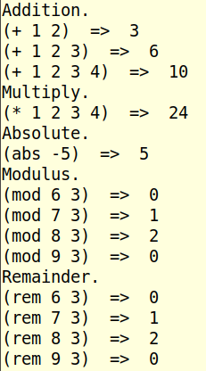
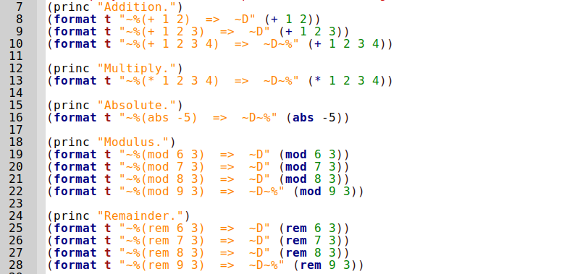
Math Functions
File: demo_math.lisp

Slide 41
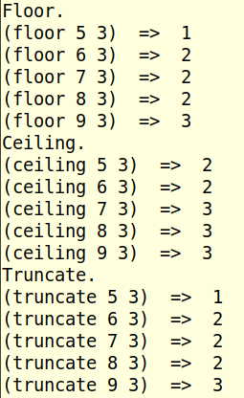
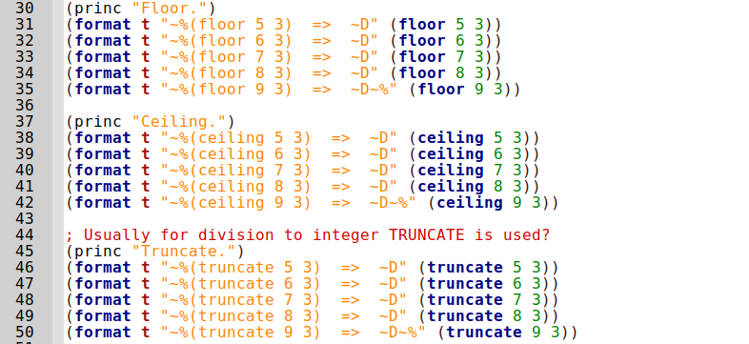
Math Functions
File: demo_math.lisp

Slide 42
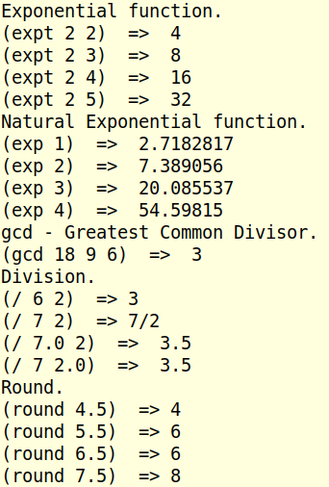
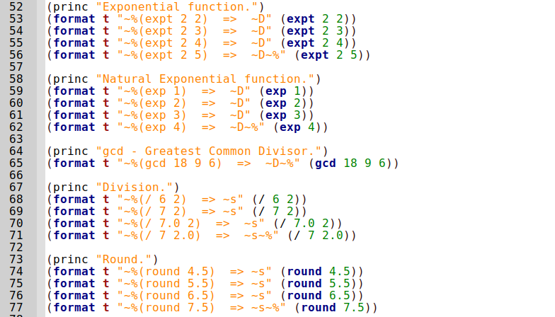
Math Functions
File: demo_math.lisp

Slide 43
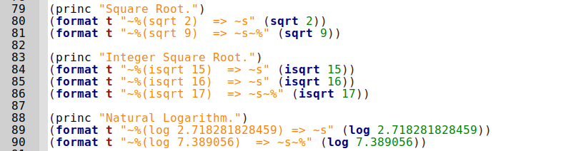
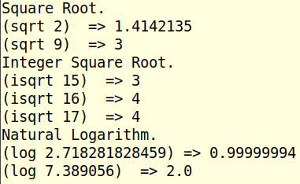
Math Functions
File: demo_math.lisp

Slide 44
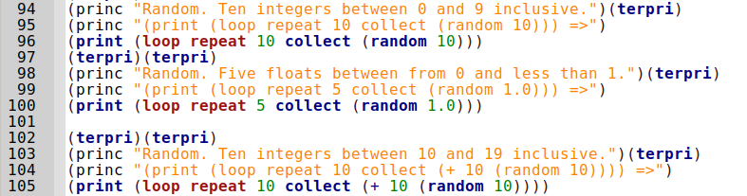
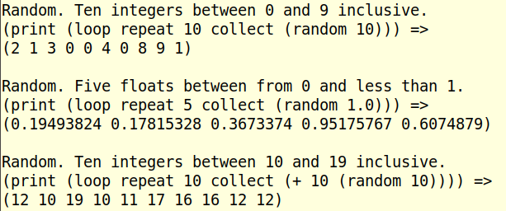
Math Functions
File: demo_math.lisp

Slide 45
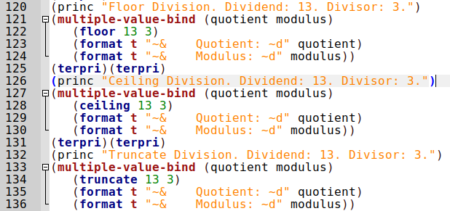
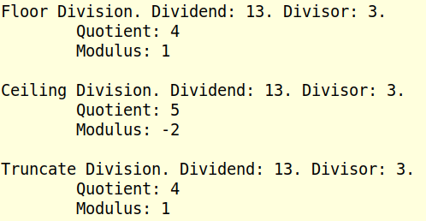
Math Functions
Positive: Truncate is like Floor.
File: demo_math.lisp

Slide 46
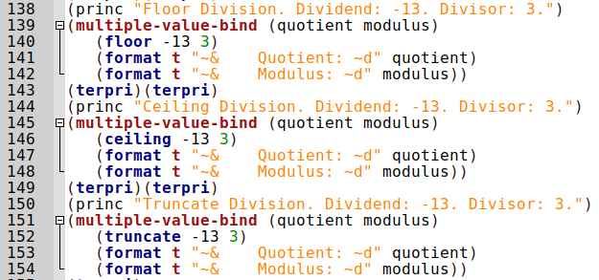
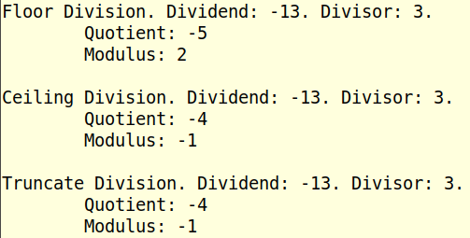
Math Functions
Negative: Truncate is like Ceiling.
File: demo_math.lisp

Slide 47
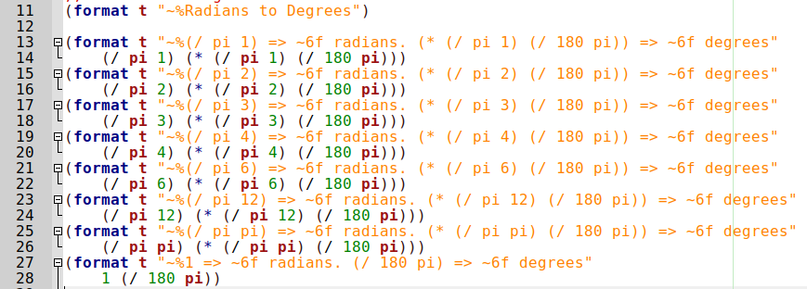
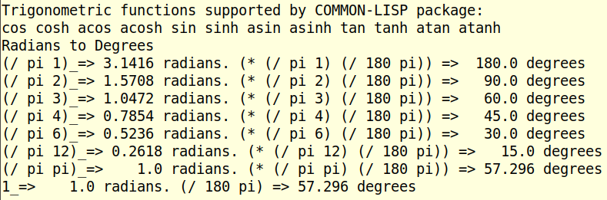
Trig
Functions
File: demo_trig.lisp

Slide 48
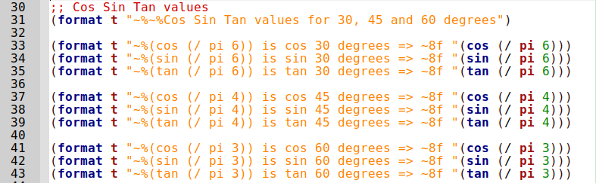
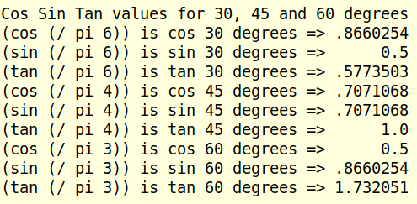
Trig
Functions
File: demo_trig.lisp

Slide 49
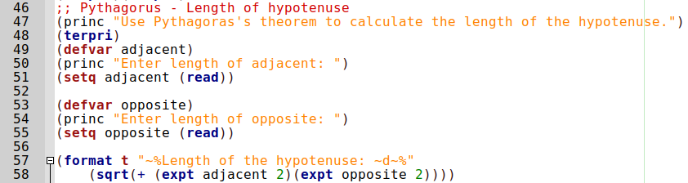
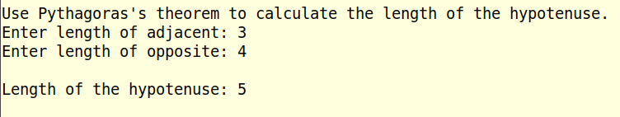
Trig Functions
File: demo_trig.lisp

Slide 50
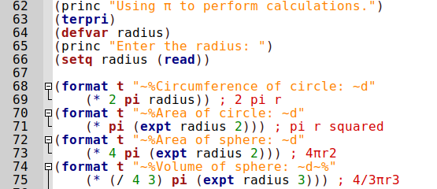
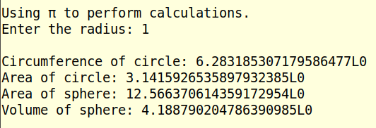
Trig Functions
File: demo_trig.lisp

Slide 51
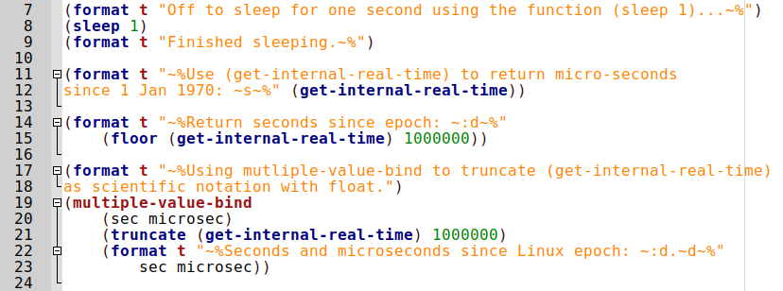
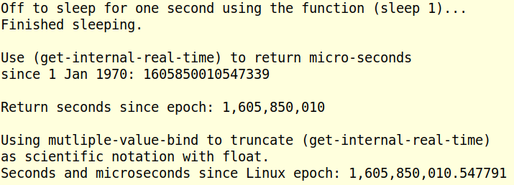
Date and Time Functions
File: demo_date.lisp

Slide 52
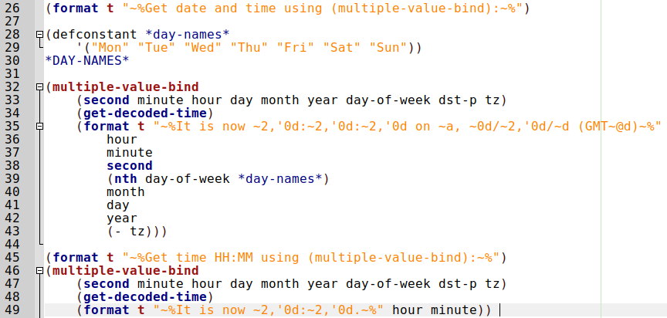

Date and Time Functions
File: demo_date.lisp

Slide 53

File I/O. Using with-open-file.
:direction
:input
:output
:io
:probe
Set variable for /tmp file
Uncomment to reset with file deleted.
Probe for files existance. Just curious.
:if exists
:error
:new-version
:rename
:rename-and-delete
:append
:supersede
Desire is to append, but need create if the file doesn’t exist.
:if-does-not-exist
:error
:create
Read the contents of the file and display on the console.
File: demo_file.lisp

Slide 54


File I/O. Using with-open-file.
First time. File is created.
Third time. File is appended.
Three lines of data. One for each time the program was run.
File: demo_file.lisp

Slide 55

File I/O. Using with-open-file. Call Function
Define write-file function
Call write-file function
Define read-file function
Call read-file function
File: demo_file.lisp

Slide 56

File I/O. Using with-open-file. Call Function
File is superseded.
Content of file.
File: demo_file.lisp

Slide 57

Lisp: Any Questions? Run Demo Code?
Not Covered:
String manipulation – Only “format” function. See https://lispcookbook.github.io/cl-cookbook/strings.html
Packages. All 15000 of them!
The LISP kernel addon for Jupyter-Notebook.
Compiling executable code.
Common lisp is an interpreted language ?
"dumping an image" in lisp
Setf is very important in lisp
asdf (more or less the lisp equivalent to gnu make)
Lambdas and closures
The common lisp object system.
Macroexpand and disassemble
Geany IDE Modificatons. See Appendix 1. Next two slides
Apropos function. See Appendix 2.
Tree data structure representing the S-expression (* 2 (+ 3 4))

Slide 58
Appendix 1: Geany IDE Modifications.
Supports LISP
Install from debian repositories: $ sudo apt install geany
Default console is: uxterm. Change to Mate-terminal.
Edit -> Preferences -> Tools -> Terminal: mate-terminal -e "/bin/sh %c"
Select whether to launch SBCL or CLISP.
Build -> Set Build Commands -> Execute Commands:
  CLISP: clisp "%f"
  SBCL: sbcl --script "%f"
“Underscore” bug. https://www.geany.org/documentation/faq/
Fixed in Geany 1.37. For 1.36 and below...
Tools -> Configuration Files -> filetypes.common -> then uncomment:
  [styling]
  line_height=0;2;

Slide 59



Geany IDE Modifications
Edit -> Preferences -> Tools ->
Build -> Set Build Commands ->
Tools -> Configuration Files -> filetypes.common ->

Slide 60
Appendix 2: apropos and apropos-list functions
Find your way around all the functions.
https://dept-info.labri.fr/~strandh/Teaching/MTP/Common/David-Lamkins/chapter10.html
http://www.lispworks.com/documentation/HyperSpec/Body/f_apropo.htm
Examples:
* (apropos "COS" :common-lisp)
ACOS (fbound)
ACOSH (fbound)
COS (fbound)
COSH (fbound)
* (apropos "ACOSH")
SB-C::ACOSH-DERIVE-TYPE-OPTIMIZER (fbound)
SB-KERNEL::COMPLEX-ACOSH (fbound)
SB-KERNEL:%ACOSH (fbound)
ACOSH (fbound)
* (apropos-list "COS" :common-lisp)
(ACOS ACOSH COS COSH)
In common-lisp package find the trigonometric functions related to COS
In any package find functions related to ACOSH
Return a list from common-lisp package of any functions related to COS

